Slide 1

A Simple Smart Home
Middleware Technologies for Distributed Systems 2020/2021

Slide 2
Problem
Create a control panel to coordinate HVAC systems in different rooms
User can manage all the rooms from a control panel

Slide 3
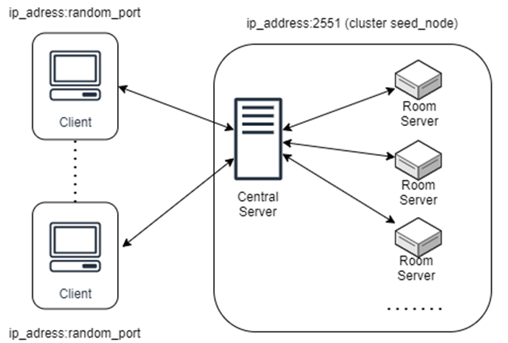
Architecture
Built with Akka actor model
Distributed architecture on different machines
Central server as supervisor and central point of access
Room servers to manage the sensors of each room

Slide 4
Clients
A user can decide to:
Create a new room
Request to the server the list of all the registered rooms
Request to a room the current data
Set the target temperature and humidity for a room
Delete an existing room
Each one of these operations will send a message to the central server.

Slide 5
Central server
Cluster seed-node
allows other actors to connect to the cluster
Supervisor
implements resume strategy to turn back on crashing actors
List of rooms
Stores a list of all the active rooms in the system
Receives and forewards messages from the clients to the correct room
Message forewarding

Slide 6
Simulates sensors data
Consumes energy according to what part of the system is active
Receives messages and creates responses
Room servers

Slide 7
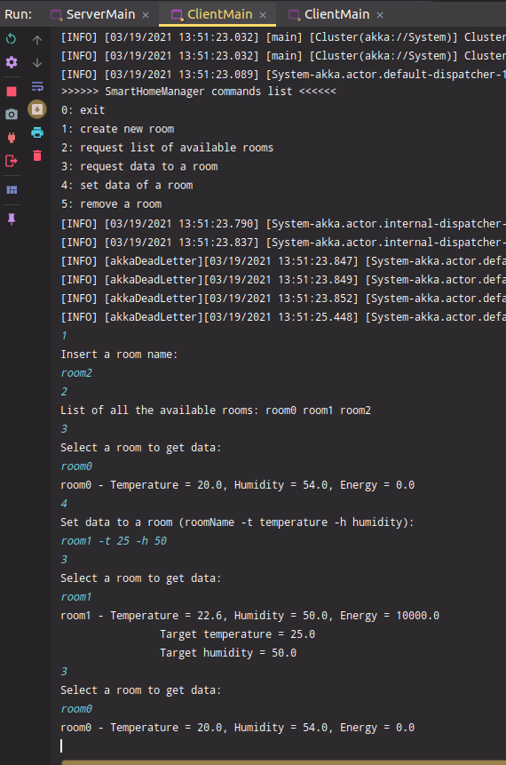
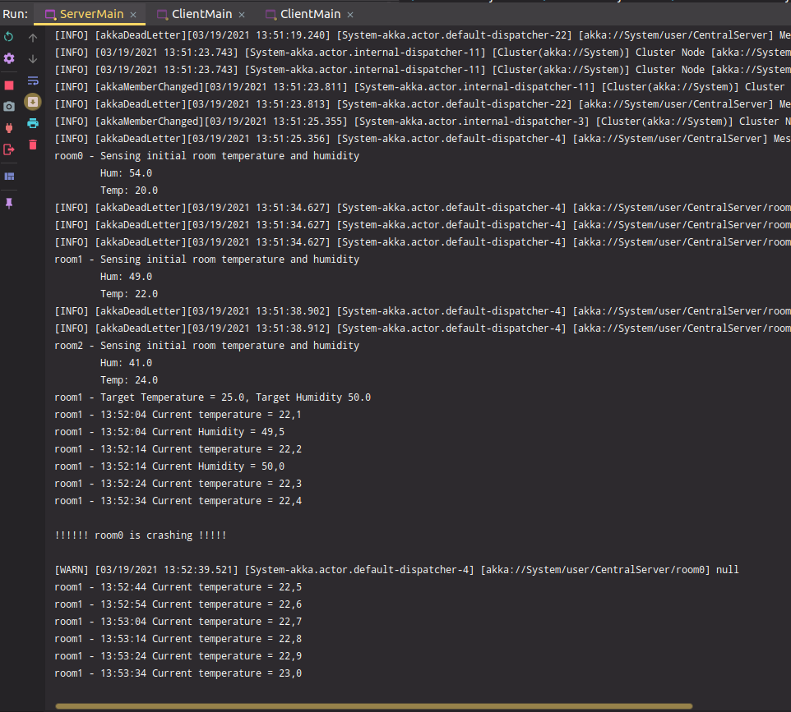
Testing & Conclusions
Test 1:
Run different processes on the same machine
Test 2:
Run clients and server on different machines

